Slide 1
Warm-up as You Walk In (Repeat)
Given
Set actions (persistent/static)
Set states (persistent/static)
Function T(s,a,s_prime)
Write the pseudo code for:
function V(s) return value
that implements:

Slide 2
Announcements
Assignments:
HW7
Due Wed 3/20, 10 pm
HW8
Plan: Out tomorrow, due M 3/25
P4
Plan: Out tomorrow, due Thu 3/28

Slide 3
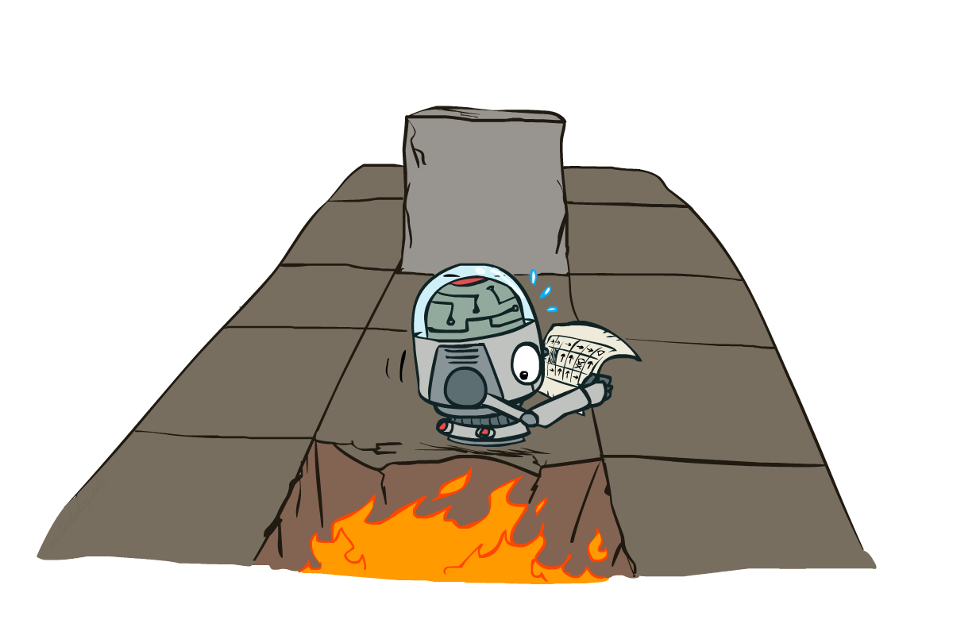
AI: Representation and Problem Solving
Markov Decision Processes II
Instructors: Pat Virtue & Stephanie Rosenthal
Slide credits: CMU AI and http://ai.berkeley.edu

Slide 4





Example: Grid World
A maze-like problem
The agent lives in a grid
Walls block the agent’s path
Noisy movement: actions do not always go as planned
80% of the time, the action North takes the agent North
10% of the time, North takes the agent West; 10% East
If there is a wall in the direction the agent would have been taken, the agent stays put
The agent receives rewards each time step
Small “living” reward each step (can be negative)
Big rewards come at the end (good or bad)
Notes:
[cut demo of moving around in grid world program]

Slide 5





Example: Grid World
A maze-like problem
The agent lives in a grid
Walls block the agent’s path
Noisy movement: actions do not always go as planned
80% of the time, the action North takes the agent North
10% of the time, North takes the agent West; 10% East
If there is a wall in the direction the agent would have been taken, the agent stays put
The agent receives rewards each time step
Small “living” reward each step (can be negative)
Big rewards come at the end (good or bad)
Goal: maximize sum of (discounted) rewards
Notes:
[cut demo of moving around in grid world program]

Slide 6
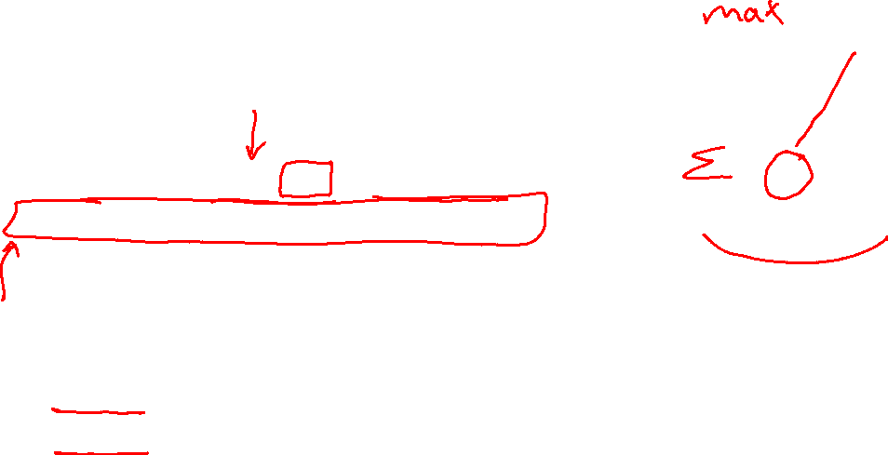
Recap: MDPs
s
Markov decision processes:
States S
Actions A
Transitions P(s’|s,a) (or T(s,a,s’))
Rewards R(s,a,s’) (and discount γ)
Start state s₀
Quantities:
Policy = map of states to actions
Utility = sum of discounted rewards
Values = expected future utility from a state (max node)
Q-Values = expected future utility from a q-state (chance node)
a
s, a
s,a,s’
s’

Slide 7
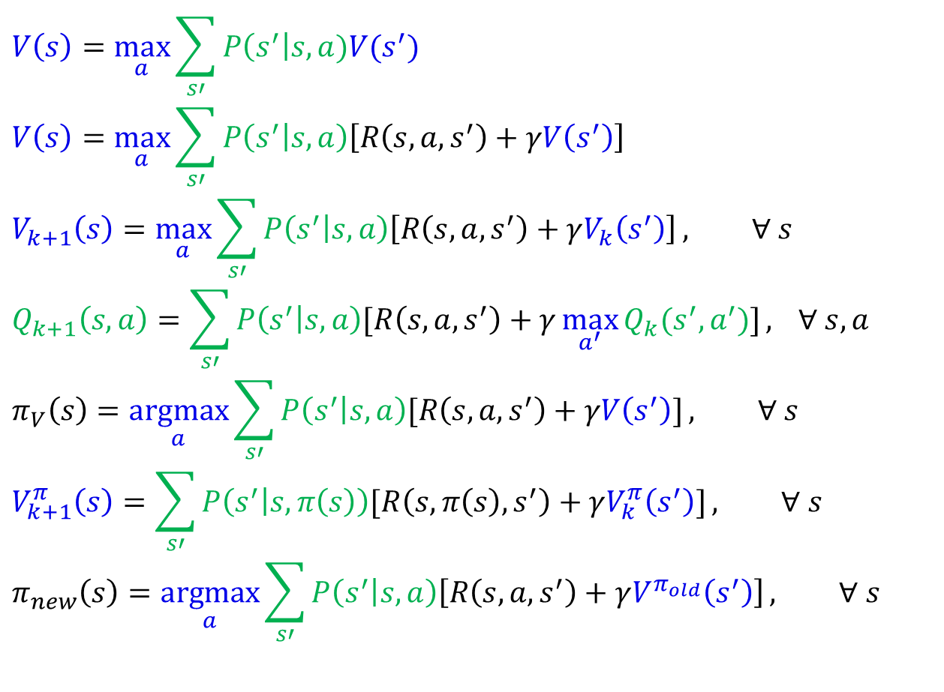

MDP Notation
$$V\left(s\right)=\max_{a}{\sum_{s′}{P\left(s^{′}\right|s,a)V(s^{′})}}$$
$$V\left(s\right)=\max_{a}{\sum_{s′}{P\left(s^{′} | s,a\right)\left[R\left(s,a,s^{′}\right)+γV\left(s^{′}\right)\right]}}$$
$$V_{k+1}\left(s\right)=\max_{a}{\sum_{s′}{P\left(s^{′} | s,a\right)\left[R\left(s,a,s^{′}\right)+γV_{k}\left(s^{′}\right)\right]}}, ∀ s$$
$$Q_{k+1}\left(s,a\right)=\sum_{s′}{P\left(s^{′} | s,a\right)[R\left(s,a,s^{′}\right)+γ\max_{a^{′}}{Q_{k}(s^{′},a^{′})]}, } ∀ s,a$$
$$π_{V}\left(s\right)=\underset{a}{argmax}{\sum_{s′}{P\left(s^{′} | s,a\right)[R\left(s,a,s^{′}\right)+γV\left(s^{′}\right)]}}, ∀ s$$
$$V_{k+1}^{π}\left(s\right)=\sum_{s′}{P\left(s^{′} | s,π\left(s\right)\right)[R\left(s,π\left(s\right),s^{′}\right)+γV_{k}^{π}\left(s^{′}\right)]}, ∀ s$$
$$π_{new}\left(s\right)=\underset{a}{argmax}{\sum_{s′}{P\left(s^{′} | s,a\right)\left[R\left(s,a,s^{′}\right)+γV^{π_{old}}\left(s^{′}\right)\right]}}, ∀ s$$
Standard expectimax:
Bellman equations:
Value iteration:
Q-iteration:
Policy extraction:
Policy evaluation:
Policy improvement:

Slide 8
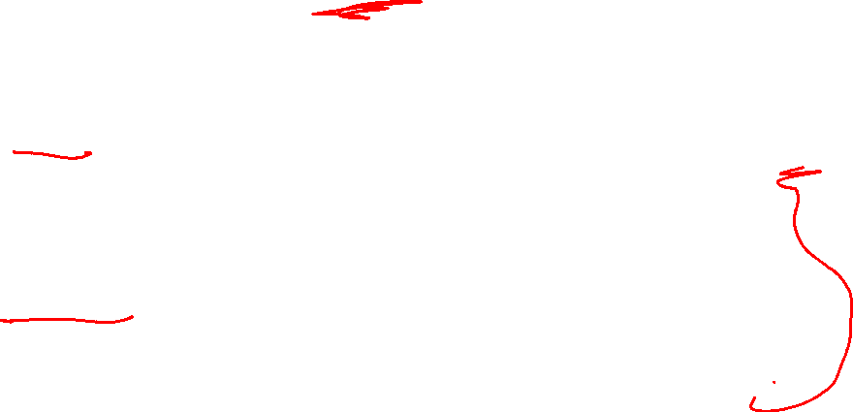
Optimal Quantities
s
The value (utility) of a state s:
V*(s) = expected utility starting in s and acting optimally
The value (utility) of a q-state (s,a):
Q*(s,a) = expected utility starting out having taken action a from state s and (thereafter) acting optimally
The optimal policy:
π*(s) = optimal action from state s
a
s, a
s,a,s’
s’
[Demo: gridworld values (L9D1)]
Notes:
Demo just shows V and Q values, snapshots on next slides.

Slide 9
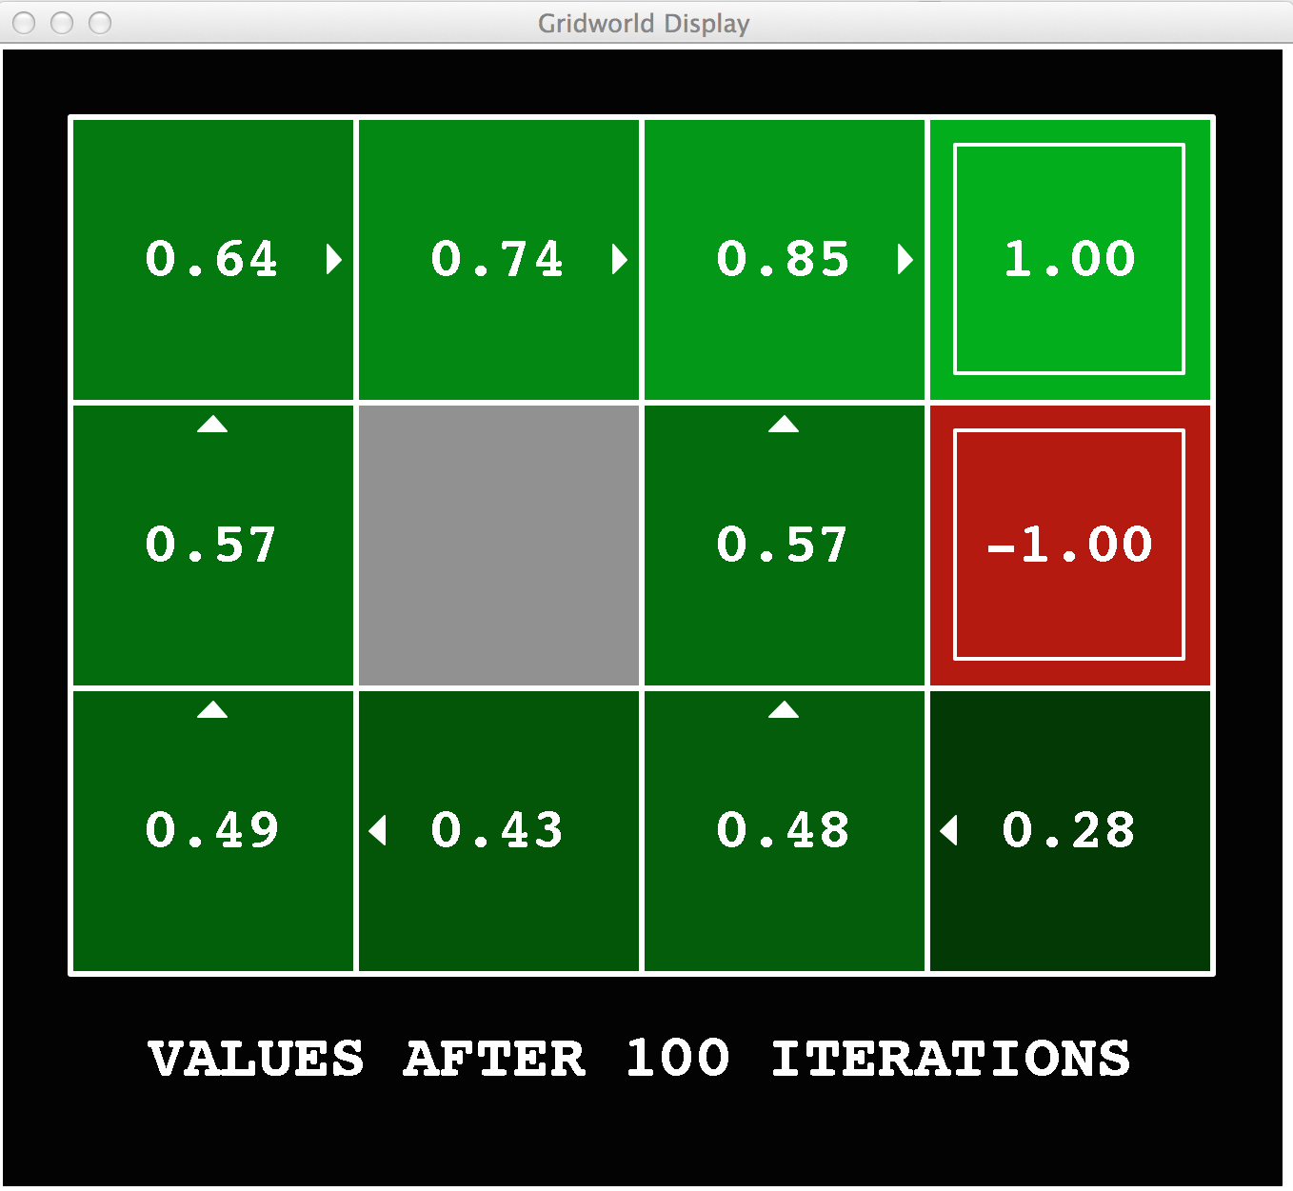
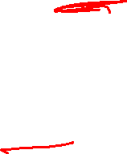
Gridworld Values V*

Slide 10
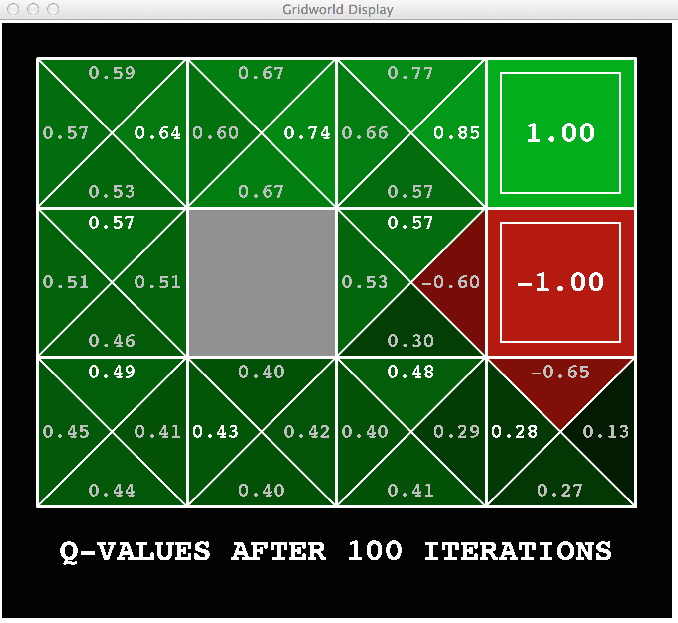
Gridworld: Q*

Slide 11

The Bellman Equations
How to be optimal:
Step 1: Take correct first action
Step 2: Keep being optimal

Slide 12


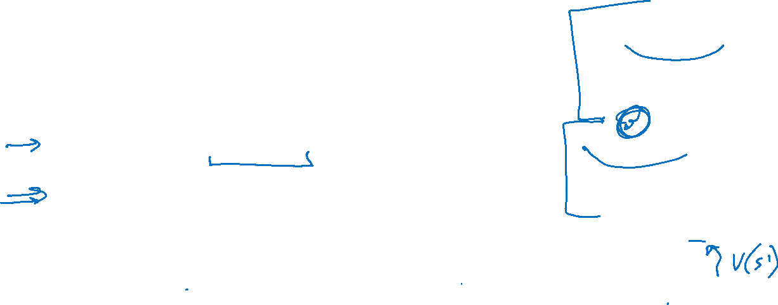
The Bellman Equations
s
Definition of “optimal utility” via expectimax recurrence gives a simple one-step lookahead relationship amongst optimal utility values
These are the Bellman equations, and they characterize optimal values in a way we’ll use over and over
a
s, a
s,a,s’
s’
Notes:
Let’s start by equations that characterize these quantities through mutual recursions. [step through this by writing on slide, one step at a time]
Recursive characterization of V* in terms of V*; not necessarily helpful; but it is a characterization.
Note: this is a set of equations that needs to be satisfied; but it could have multiple solutions (it does not, but at this stage of our knowledge it could).

Slide 13

Solving MDPs

Slide 14
Solving Expectimax

Slide 15
Solving Expectimax

Slide 16
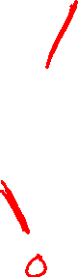
Solving Expectimax

Slide 17
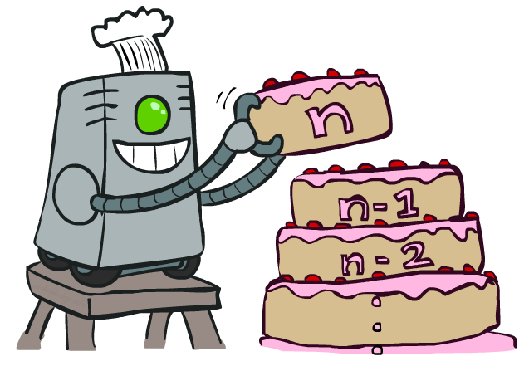
Value Iteration

Slide 18
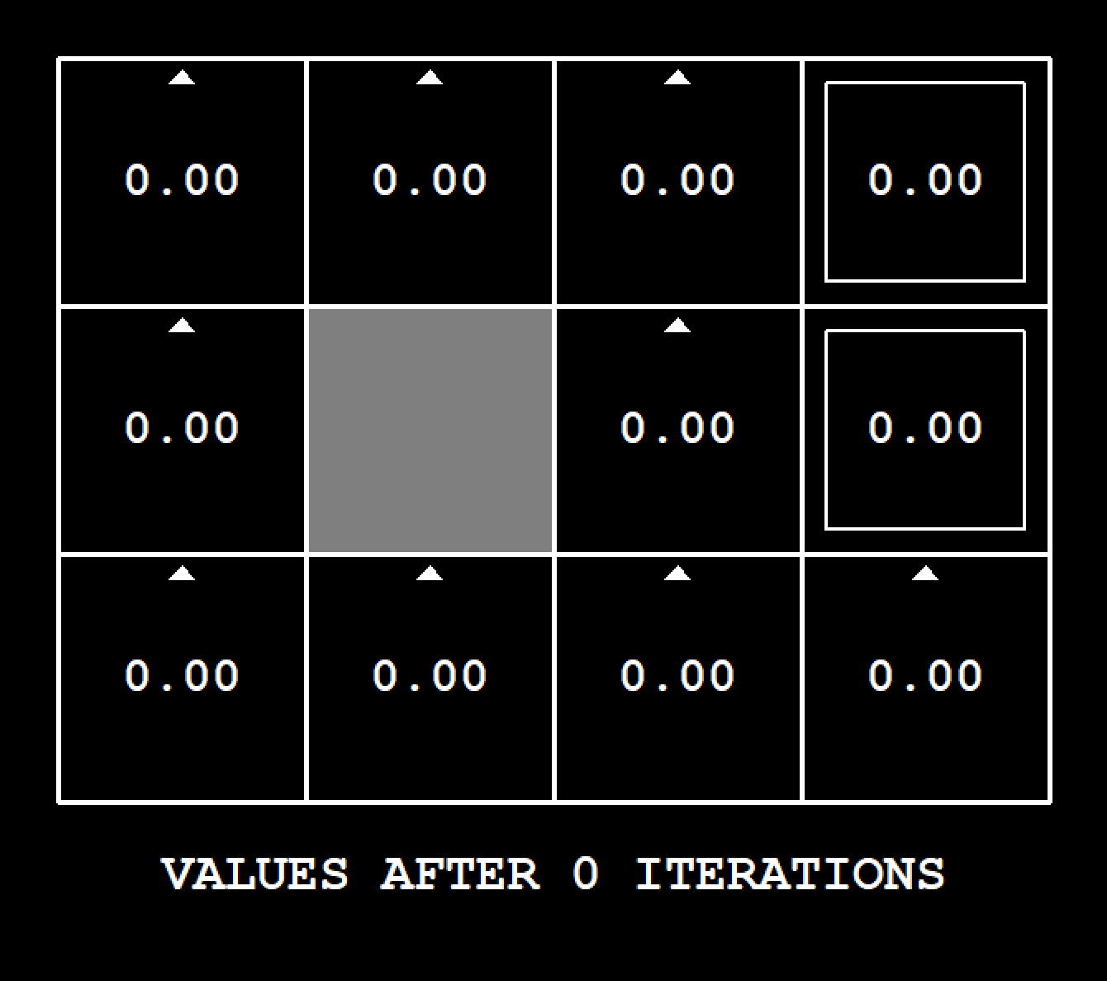
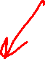
Demo Value Iteration
[Demo: value iteration (L8D6)]

Slide 19
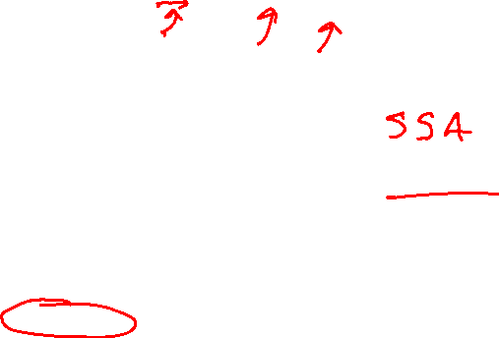
Value Iteration
Start with V₀(s) = 0: no time steps left means an expected reward sum of zero
Given vector of V_{k}(s) values, do one ply of expectimax from each state:
Repeat until convergence
Complexity of each iteration: O(S²A)
Theorem: will converge to unique optimal values
Basic idea: approximations get refined towards optimal values
Policy may converge long before values do
V_{k+1}(s)
a
s, a
s,a,s’
V_{k}(s’)
Notes:
Discuss computational complexity: S * A * S times number of iterations
Note: updates not in place [if in place, it means something else and not even clear what it means]

Slide 20
Value Iteration
s
Bellman equations characterize the optimal values:
Value iteration computes them:
Value iteration is just a fixed point solution method
… though the V_{k} vectors are also interpretable as time-limited values
a
s, a
s,a,s’
Notes:
Discuss computational complexity: S * A * S times number of iterations
Note: updates not in place [if in place, it means something else and not even clear what it means]

Slide 21
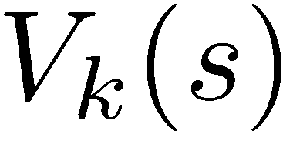
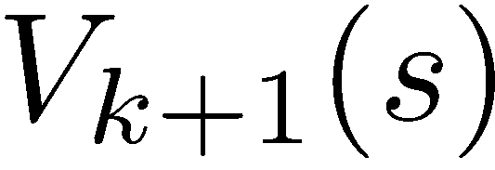
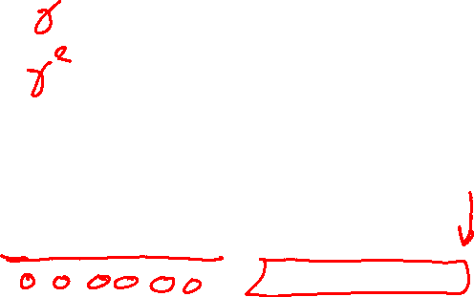
Value Iteration Convergence
How do we know the V_{k} vectors are going to converge?
Case 1: If the tree has maximum depth M, then V_{M} holds the actual untruncated values
Case 2: If the discount is less than 1
Sketch: For any state V_{k} and V_{k+1} can be viewed as depth k+1 expectimax results in nearly identical search trees
The difference is that on the bottom layer, V_{k+1} has actual rewards while V_{k} has zeros
That last layer is at best all R_{MAX}
It is at worst R_{MIN}
But everything is discounted by γ^{k} that far out
So V_{k} and V_{k+1} are at most γ^{k} max|R| different
So as k increases, the values converge

Slide 22
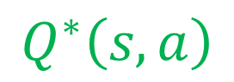
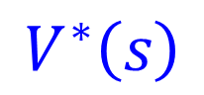
Solved MDP! Now what?
What are we going to do with these values??
$$V^{∗}\left(s\right)$$
$$Q^{∗}\left(s,a\right)$$

Slide 23
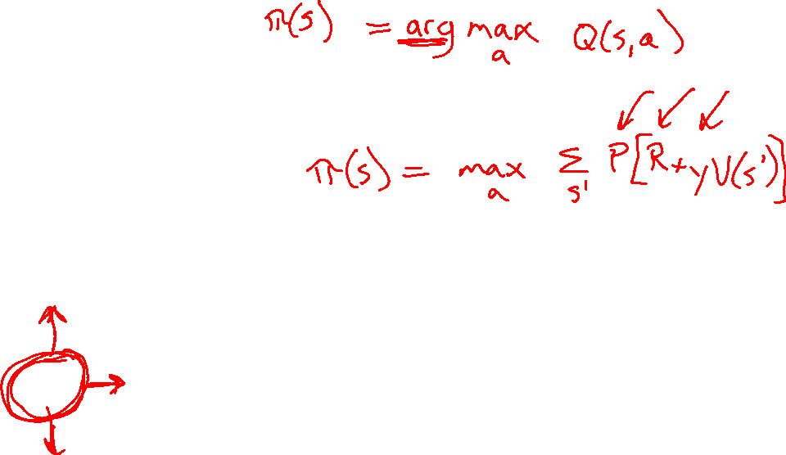
Piazza Poll 1
If you need to extract a policy, would you rather have
Values or Q-values?

Slide 24
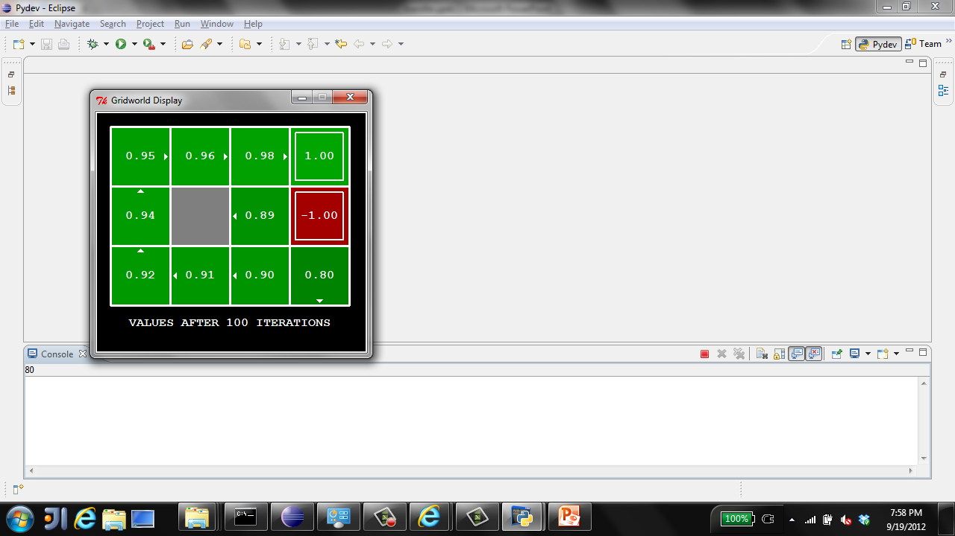
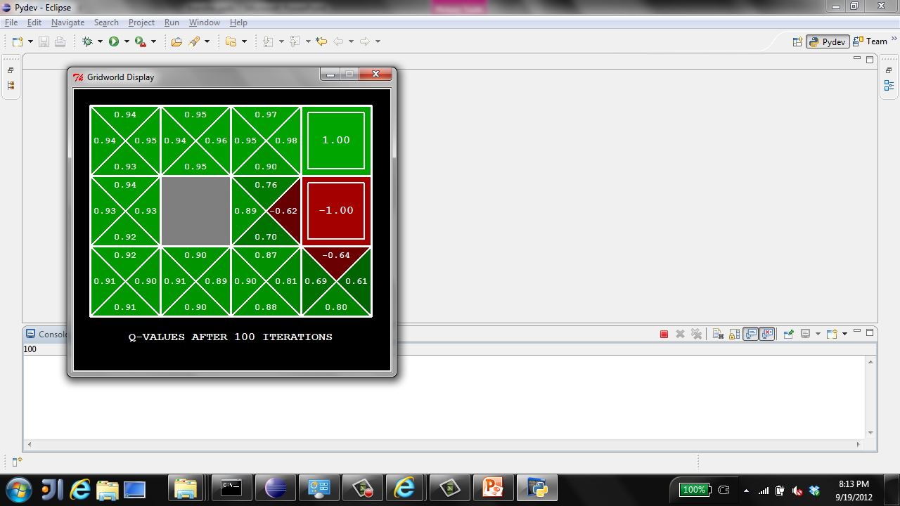
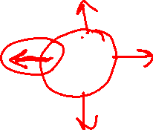
Piazza Poll 1
If you need to extract a policy, would you rather have
Values or Q-values?

Slide 25

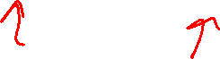
Policy Methods

Slide 26

Policy Evaluation

Slide 27
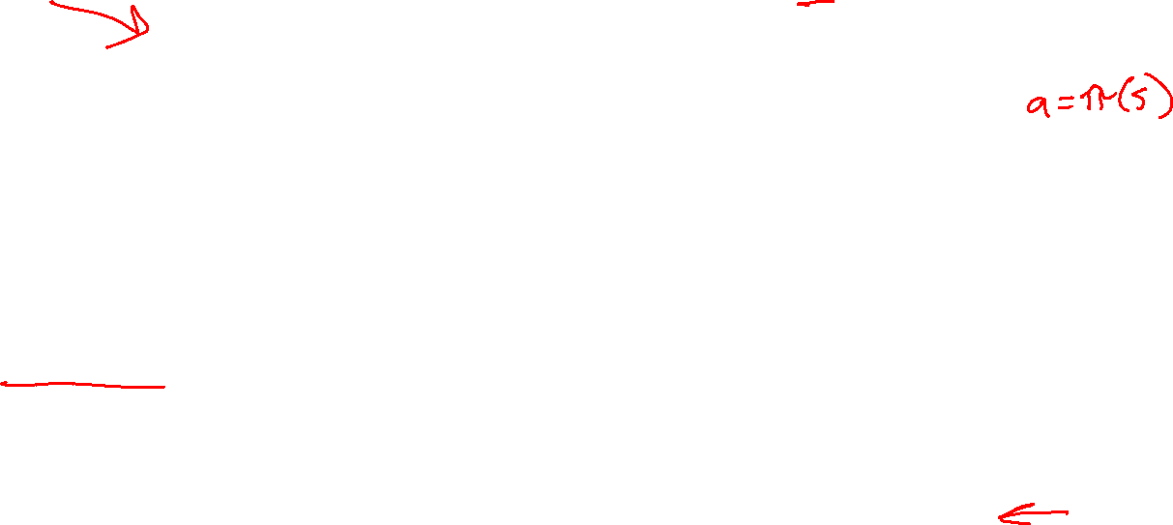
Fixed Policies
Do the optimal action
Do what π says to do
s
s
a
π(s)
s, a
s, π(s)
s,a,s’
s, π(s),s’
s’
s’
Expectimax trees max over all actions to compute the optimal values
If we fixed some policy π(s), then the tree would be simpler – only one action per state
… though the tree’s value would depend on which policy we fixed

Slide 28
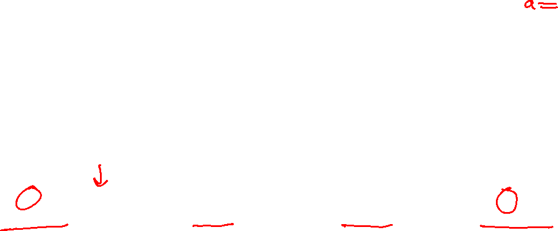
Utilities for a Fixed Policy
Another basic operation: compute the utility of a state s under a fixed (generally non-optimal) policy
Define the utility of a state s, under a fixed policy π:
V^{π}(s) = expected total discounted rewards starting in s and following π
Recursive relation (one-step look-ahead / Bellman equation):
s
π(s)
s, π(s)
s, π(s),s’
s’

Slide 29
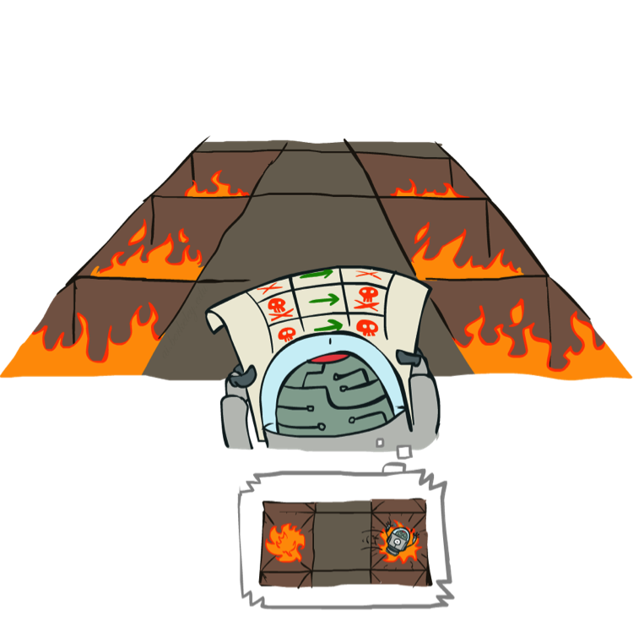
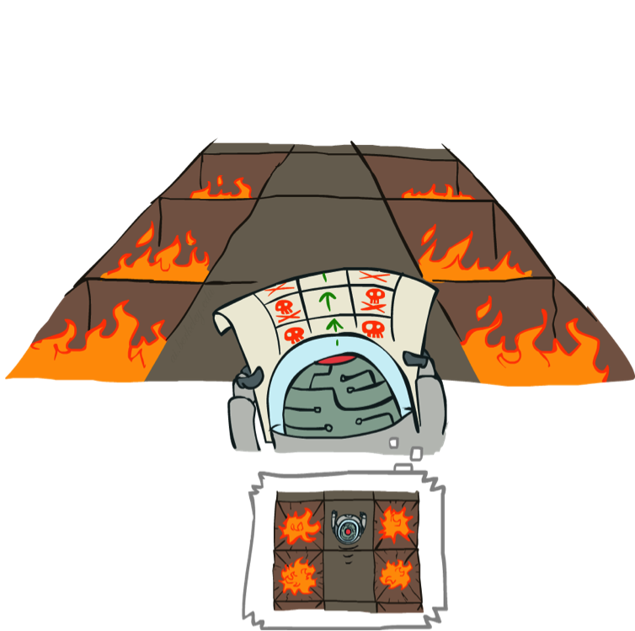
Example: Policy Evaluation
Always Go Right
Always Go Forward

Slide 30
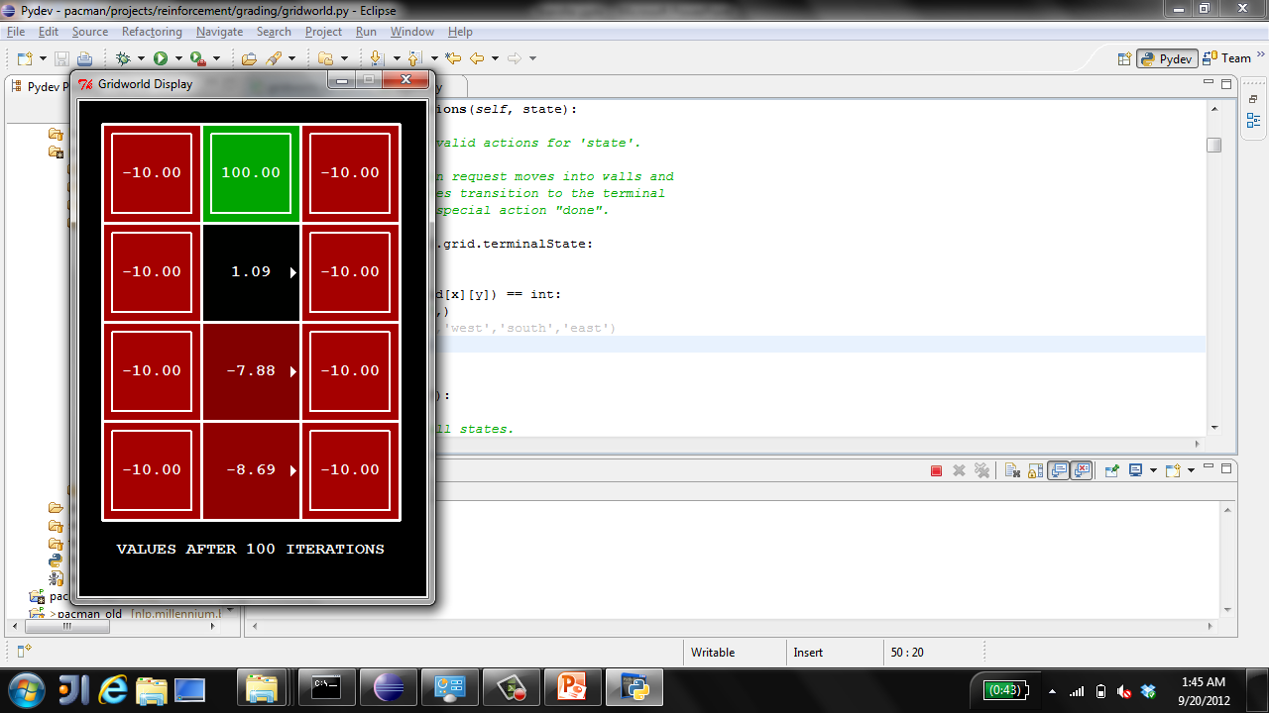
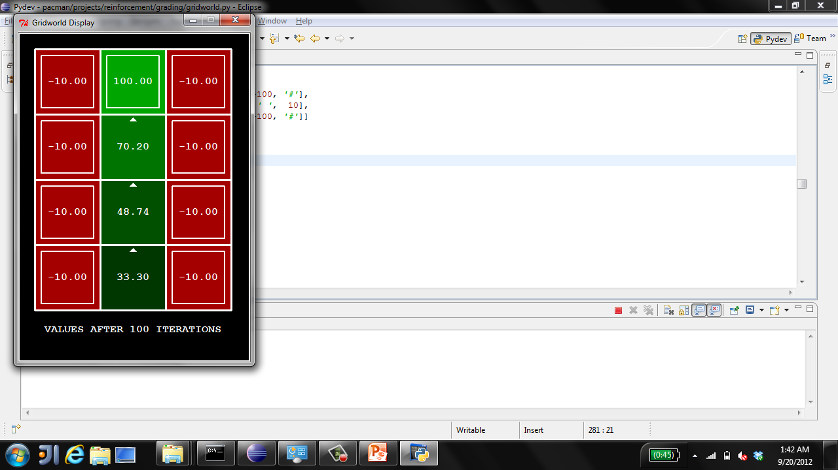

Example: Policy Evaluation
Always Go Right
Always Go Forward

Slide 31

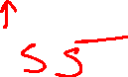
Policy Evaluation
How do we calculate the V’s for a fixed policy π?
Idea 1: Turn recursive Bellman equations into updates
(like value iteration)
Efficiency: O(S²) per iteration
Idea 2: Without the maxes, the Bellman equations are just a linear system
Solve with your favorite linear system solver
s
π(s)
s, π(s)
s, π(s),s’
s’

Slide 32
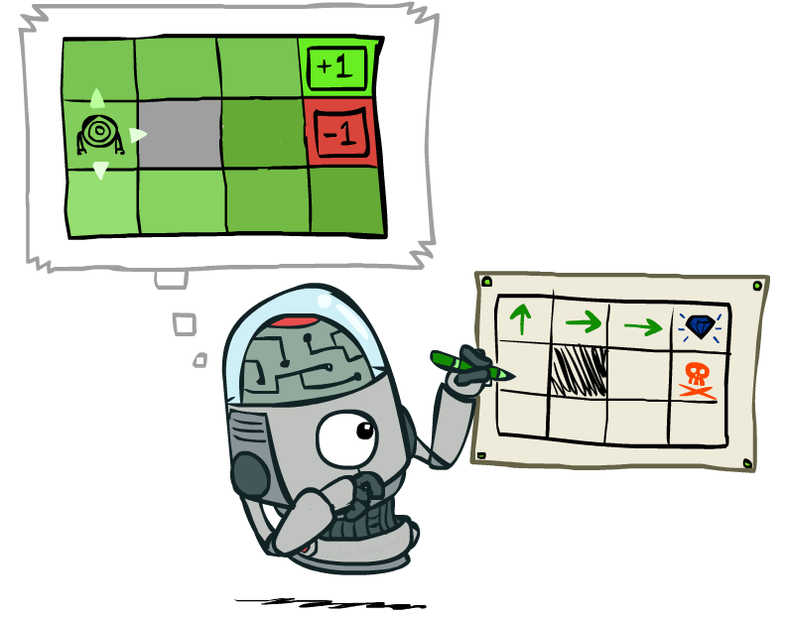
Policy Extraction

Slide 33
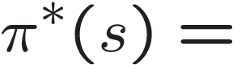
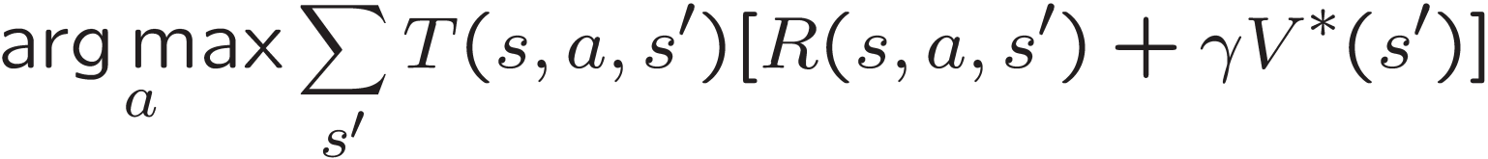
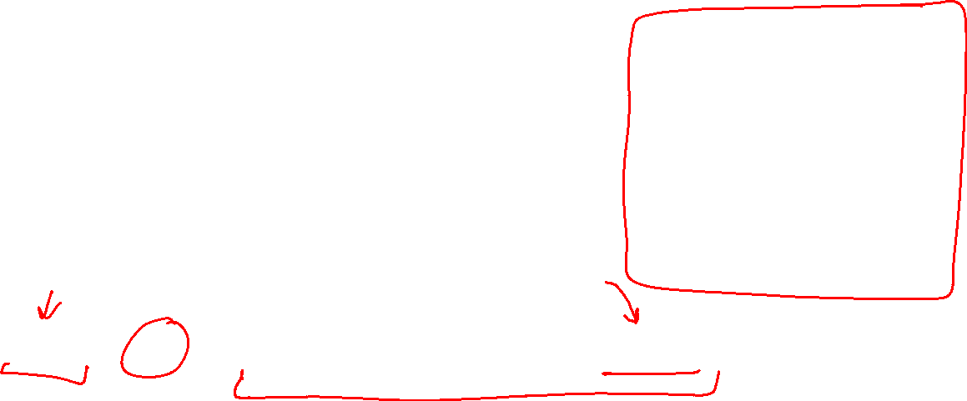
Computing Actions from Values
Let’s imagine we have the optimal values V*(s)
How should we act?
It’s not obvious!
We need to do a mini-expectimax (one step)
This is called policy extraction, since it gets the policy implied by the values

Slide 34
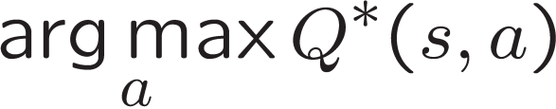
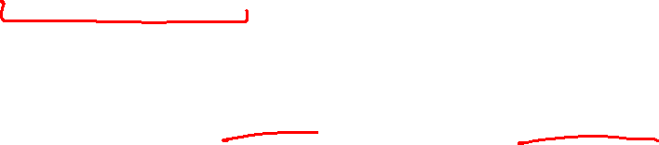
Computing Actions from Q-Values
Let’s imagine we have the optimal q-values:
How should we act?
Completely trivial to decide!
Important lesson: actions are easier to select from q-values than values!

Slide 35

Policy Iteration

Slide 36

Problems with Value Iteration
Value iteration repeats the Bellman updates:
Problem 1: It’s slow – O(S²A) per iteration
Problem 2: The “max” at each state rarely changes
Problem 3: The policy often converges long before the values
s
a
s, a
s,a,s’
s’
[Demo: value iteration (L9D2)]
Notes:
Demo steps through value iteration; snapshots of values shown on next slides.

Slide 37
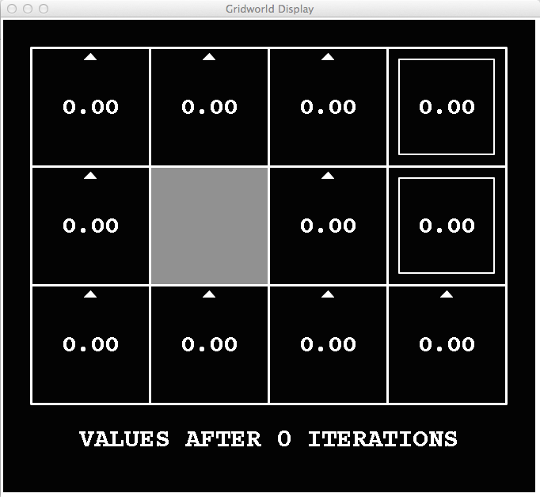
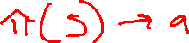
k=0
Noise = 0.2
Discount = 0.9
Living reward = 0
Notes:
Assuming zero living reward

Slide 38
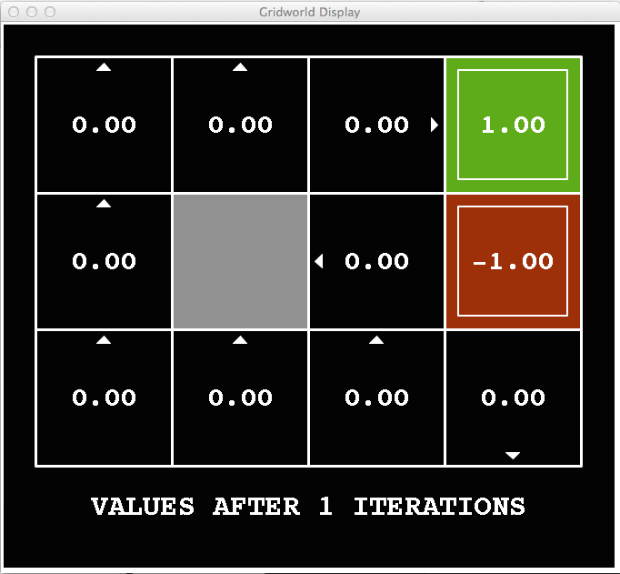
k=1
Noise = 0.2
Discount = 0.9
Living reward = 0
Notes:
Assuming zero living reward

Slide 39
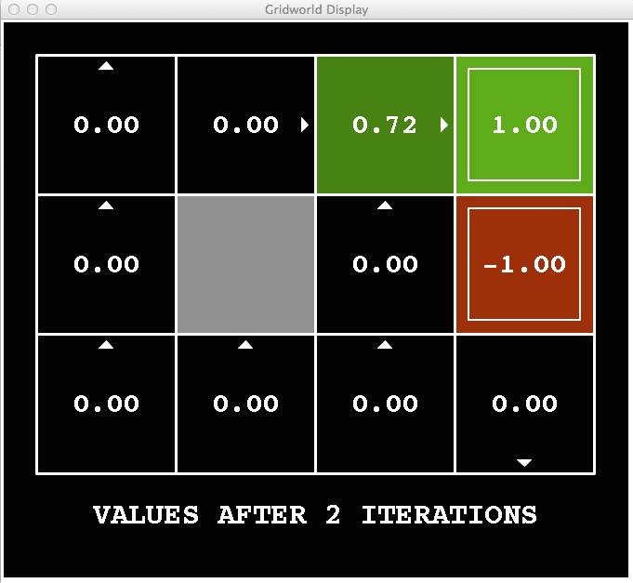
k=2
Noise = 0.2
Discount = 0.9
Living reward = 0
Notes:
Assuming zero living reward

Slide 40
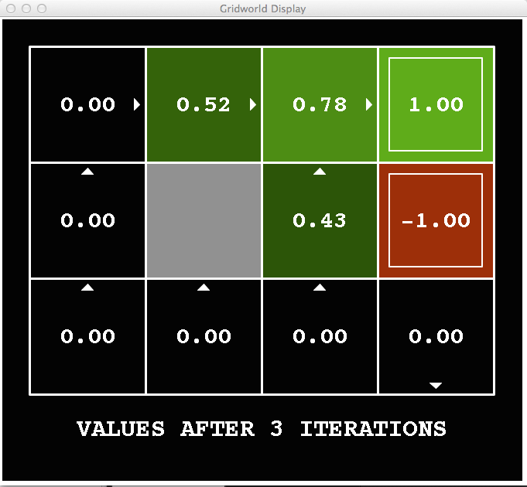
k=3
Noise = 0.2
Discount = 0.9
Living reward = 0
Notes:
Assuming zero living reward

Slide 41
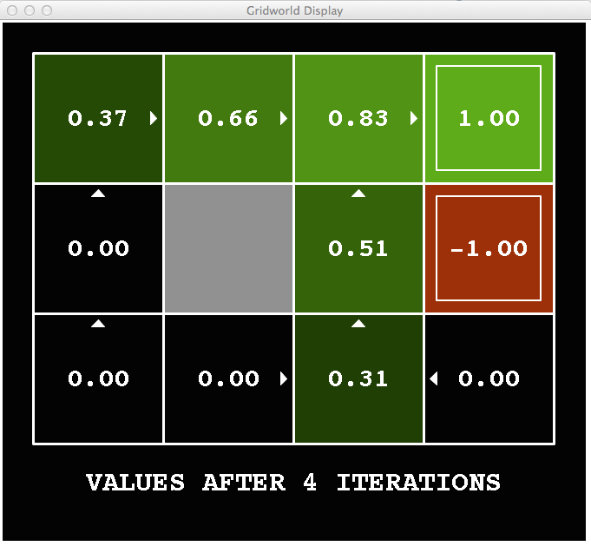
k=4
Noise = 0.2
Discount = 0.9
Living reward = 0
Notes:
Assuming zero living reward

Slide 42
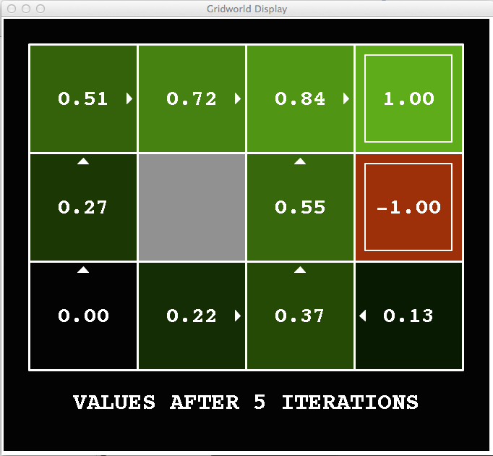
k=5
Noise = 0.2
Discount = 0.9
Living reward = 0
Notes:
Assuming zero living reward

Slide 43
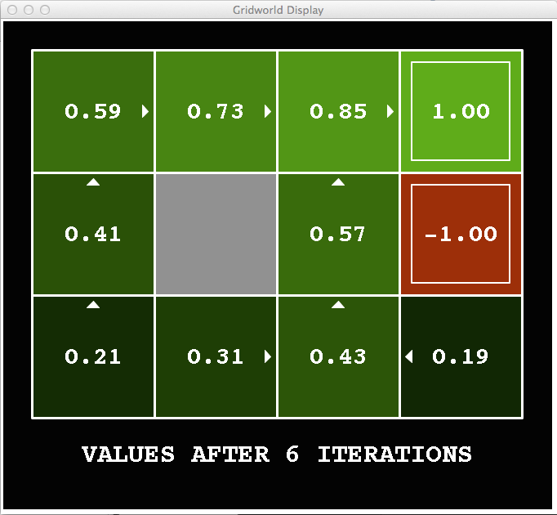
k=6
Noise = 0.2
Discount = 0.9
Living reward = 0
Notes:
Assuming zero living reward

Slide 44
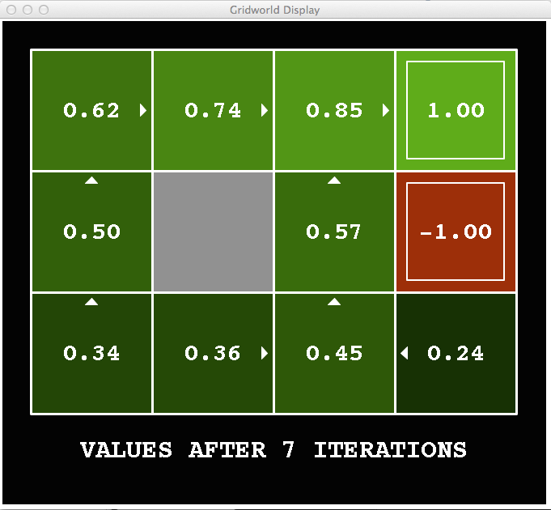
k=7
Noise = 0.2
Discount = 0.9
Living reward = 0
Notes:
Assuming zero living reward

Slide 45
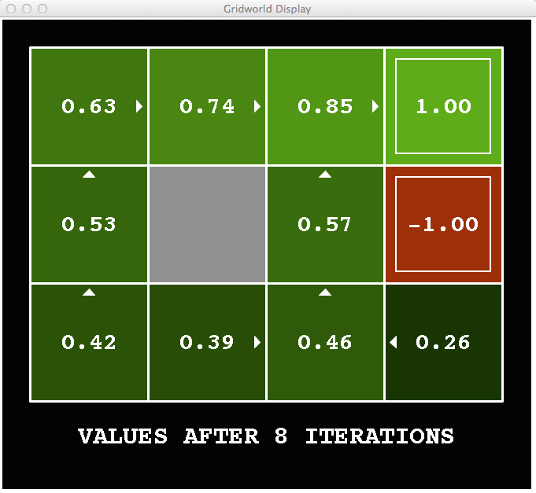
k=8
Noise = 0.2
Discount = 0.9
Living reward = 0
Notes:
Assuming zero living reward

Slide 46
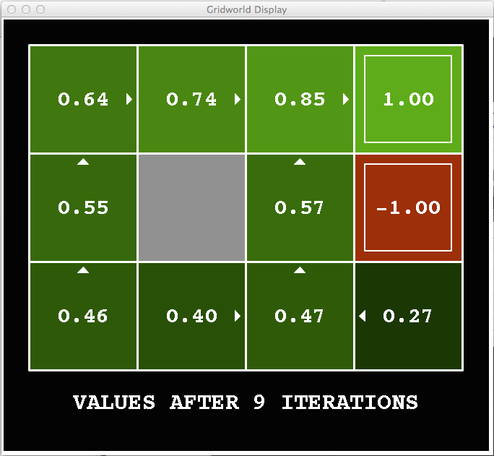
k=9
Noise = 0.2
Discount = 0.9
Living reward = 0
Notes:
Assuming zero living reward

Slide 47

k=10
Noise = 0.2
Discount = 0.9
Living reward = 0
Notes:
Assuming zero living reward

Slide 48

k=11
Noise = 0.2
Discount = 0.9
Living reward = 0
Notes:
Assuming zero living reward

Slide 49
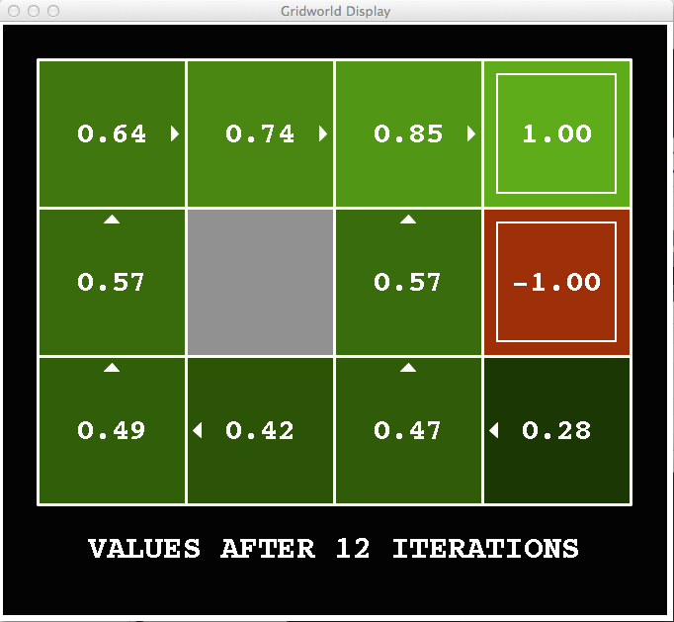
k=12
Noise = 0.2
Discount = 0.9
Living reward = 0
Notes:
Assuming zero living reward

Slide 50

k=100
Noise = 0.2
Discount = 0.9
Living reward = 0
Notes:
Assuming zero living reward

Slide 51

Policy Iteration
Alternative approach for optimal values:
Step 1: Policy evaluation: calculate utilities for some fixed policy (not optimal utilities!) until convergence
Step 2: Policy improvement: update policy using one-step look-ahead with resulting converged (but not optimal!) utilities as future values
Repeat steps until policy converges
This is policy iteration
It’s still optimal!
Can converge (much) faster under some conditions

Slide 52
Policy Iteration
Evaluation: For fixed current policy π, find values with policy evaluation:
Iterate until values converge:
Improvement: For fixed values, get a better policy using policy extraction
One-step look-ahead:

Slide 53
Comparison
Both value iteration and policy iteration compute the same thing (all optimal values)
In value iteration:
Every iteration updates both the values and (implicitly) the policy
We don’t track the policy, but taking the max over actions implicitly recomputes it
In policy iteration:
We do several passes that update utilities with fixed policy (each pass is fast because we consider only one action, not all of them)
After the policy is evaluated, a new policy is chosen (slow like a value iteration pass)
The new policy will be better (or we’re done)
(Both are dynamic programs for solving MDPs)

Slide 54
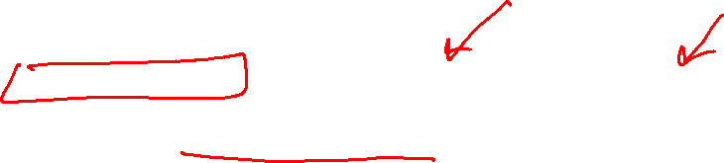
Summary: MDP Algorithms
So you want to….
Compute optimal values: use value iteration or policy iteration
Compute values for a particular policy: use policy evaluation
Turn your values into a policy: use policy extraction (one-step lookahead)
These all look the same!
They basically are – they are all variations of Bellman updates
They all use one-step lookahead expectimax fragments
They differ only in whether we plug in a fixed policy or max over actions

Slide 55
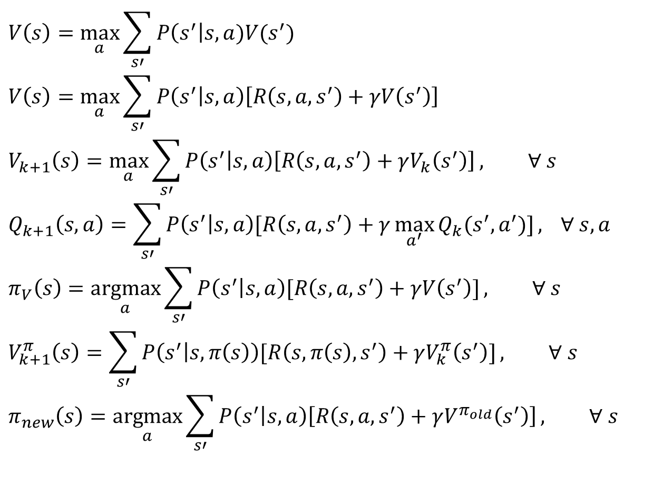
MDP Notation
$$V\left(s\right)=\max_{a}{\sum_{s′}{P\left(s^{′}\right|s,a)V(s^{′})}}$$
$$V\left(s\right)=\max_{a}{\sum_{s′}{P\left(s^{′} | s,a\right)\left[R\left(s,a,s^{′}\right)+γV\left(s^{′}\right)\right]}}$$
$$V_{k+1}\left(s\right)=\max_{a}{\sum_{s′}{P\left(s^{′} | s,a\right)\left[R\left(s,a,s^{′}\right)+γV_{k}\left(s^{′}\right)\right]}}, ∀ s$$
$$Q_{k+1}\left(s,a\right)=\sum_{s′}{P\left(s^{′} | s,a\right)[R\left(s,a,s^{′}\right)+γ\max_{a^{′}}{Q_{k}(s^{′},a^{′})]}, } ∀ s,a$$
$$π_{V}\left(s\right)=\underset{a}{argmax}{\sum_{s′}{P\left(s^{′} | s,a\right)[R\left(s,a,s^{′}\right)+γV\left(s^{′}\right)]}}, ∀ s$$
$$V_{k+1}^{π}\left(s\right)=\sum_{s′}{P\left(s^{′} | s,π\left(s\right)\right)[R\left(s,π\left(s\right),s^{′}\right)+γV_{k}^{π}\left(s^{′}\right)]}, ∀ s$$
$$π_{new}\left(s\right)=\underset{a}{argmax}{\sum_{s′}{P\left(s^{′} | s,a\right)\left[R\left(s,a,s^{′}\right)+γV^{π_{old}}\left(s^{′}\right)\right]}}, ∀ s$$
Standard expectimax:
Bellman equations:
Value iteration:
Q-iteration:
Policy extraction:
Policy evaluation:
Policy improvement:

Slide 56
MDP Notation
$$V\left(s\right)=\max_{a}{\sum_{s′}{P\left(s^{′}\right|s,a)V(s^{′})}}$$
$$V\left(s\right)=\max_{a}{\sum_{s′}{P\left(s^{′} | s,a\right)\left[R\left(s,a,s^{′}\right)+γV\left(s^{′}\right)\right]}}$$
$$V_{k+1}\left(s\right)=\max_{a}{\sum_{s′}{P\left(s^{′} | s,a\right)\left[R\left(s,a,s^{′}\right)+γV_{k}\left(s^{′}\right)\right]}}, ∀ s$$
$$Q_{k+1}\left(s,a\right)=\sum_{s′}{P\left(s^{′} | s,a\right)[R\left(s,a,s^{′}\right)+γ\max_{a^{′}}{Q_{k}(s^{′},a^{′})]}, } ∀ s,a$$
$$π_{V}\left(s\right)=\underset{a}{argmax}{\sum_{s′}{P\left(s^{′} | s,a\right)[R\left(s,a,s^{′}\right)+γV\left(s^{′}\right)]}}, ∀ s$$
$$V_{k+1}^{π}\left(s\right)=\sum_{s′}{P\left(s^{′} | s,π\left(s\right)\right)[R\left(s,π\left(s\right),s^{′}\right)+γV_{k}^{π}\left(s^{′}\right)]}, ∀ s$$
$$π_{new}\left(s\right)=\underset{a}{argmax}{\sum_{s′}{P\left(s^{′} | s,a\right)\left[R\left(s,a,s^{′}\right)+γV^{π_{old}}\left(s^{′}\right)\right]}}, ∀ s$$
Standard expectimax:
Bellman equations:
Value iteration:
Q-iteration:
Policy extraction:
Policy evaluation:
Policy improvement:

Slide 57
MDP Notation
$$V\left(s\right)=\max_{a}{\sum_{s′}{P\left(s^{′}\right|s,a)V(s^{′})}}$$
$$V\left(s\right)=\max_{a}{\sum_{s′}{P\left(s^{′} | s,a\right)\left[R\left(s,a,s^{′}\right)+γV\left(s^{′}\right)\right]}}$$
$$V_{k+1}\left(s\right)=\max_{a}{\sum_{s′}{P\left(s^{′} | s,a\right)\left[R\left(s,a,s^{′}\right)+γV_{k}\left(s^{′}\right)\right]}}, ∀ s$$
$$Q_{k+1}\left(s,a\right)=\sum_{s′}{P\left(s^{′} | s,a\right)[R\left(s,a,s^{′}\right)+γ\max_{a^{′}}{Q_{k}(s^{′},a^{′})]}, } ∀ s,a$$
$$π_{V}\left(s\right)=\underset{a}{argmax}{\sum_{s′}{P\left(s^{′} | s,a\right)[R\left(s,a,s^{′}\right)+γV\left(s^{′}\right)]}}, ∀ s$$
$$V_{k+1}^{π}\left(s\right)=\sum_{s′}{P\left(s^{′} | s,π\left(s\right)\right)[R\left(s,π\left(s\right),s^{′}\right)+γV_{k}^{π}\left(s^{′}\right)]}, ∀ s$$
$$π_{new}\left(s\right)=\underset{a}{argmax}{\sum_{s′}{P\left(s^{′} | s,a\right)\left[R\left(s,a,s^{′}\right)+γV^{π_{old}}\left(s^{′}\right)\right]}}, ∀ s$$
Standard expectimax:
Bellman equations:
Value iteration:
Q-iteration:
Policy extraction:
Policy evaluation:
Policy improvement:

Slide 58

MDP Notation
$$V\left(s\right)=\max_{a}{\sum_{s′}{P\left(s^{′}\right|s,a)V(s^{′})}}$$
$$V\left(s\right)=\max_{a}{\sum_{s′}{P\left(s^{′} | s,a\right)\left[R\left(s,a,s^{′}\right)+γV\left(s^{′}\right)\right]}}$$
$$V_{k+1}\left(s\right)=\max_{a}{\sum_{s′}{P\left(s^{′} | s,a\right)\left[R\left(s,a,s^{′}\right)+γV_{k}\left(s^{′}\right)\right]}}, ∀ s$$
$$Q_{k+1}\left(s,a\right)=\sum_{s′}{P\left(s^{′} | s,a\right)[R\left(s,a,s^{′}\right)+γ\max_{a^{′}}{Q_{k}(s^{′},a^{′})]}, } ∀ s,a$$
$$π_{V}\left(s\right)=\underset{a}{argmax}{\sum_{s′}{P\left(s^{′} | s,a\right)[R\left(s,a,s^{′}\right)+γV\left(s^{′}\right)]}}, ∀ s$$
$$V_{k+1}^{π}\left(s\right)=\sum_{s′}{P\left(s^{′} | s,π\left(s\right)\right)[R\left(s,π\left(s\right),s^{′}\right)+γV_{k}^{π}\left(s^{′}\right)]}, ∀ s$$
$$π_{new}\left(s\right)=\underset{a}{argmax}{\sum_{s′}{P\left(s^{′} | s,a\right)\left[R\left(s,a,s^{′}\right)+γV^{π_{old}}\left(s^{′}\right)\right]}}, ∀ s$$
Standard expectimax:
Bellman equations:
Value iteration:
Q-iteration:
Policy extraction:
Policy evaluation:
Policy improvement:

Slide 59



Double Bandits

Slide 60
Double-Bandit MDP
No discount
100 time steps
Both states have the same value
Actions: Blue, Red
States: Win, Lose
0.25 $0
0.75
$2
W
L
0.25
$0
$1
1.0
$1
1.0
0.75 $2

Slide 61
Offline Planning
No discount
100 time steps
Both states have the same value
Solving MDPs is offline planning
You determine all quantities through computation
You need to know the details of the MDP
You do not actually play the game!
0.25 $0
Value
0.75
$2
0.25
$0
Play Red
150
W
L
$1
1.0
$1
1.0
0.75 $2
Play Blue
100

Slide 62
Let’s Play!
$2
$2
$0
$2
$2
$2
$2
$0
$0
$0

Slide 63
Online Planning
Rules changed! Red’s win chance is different.
?? $0
??
$2
W
L
??
$0
$1
1.0
$1
1.0
?? $2

Slide 64
Let’s Play!
$0
$0
$0
$2
$0
$2
$0
$0
$0
$0

Slide 65
What Just Happened?
That wasn’t planning, it was learning!
Specifically, reinforcement learning
There was an MDP, but you couldn’t solve it with just computation
You needed to actually act to figure it out
Important ideas in reinforcement learning that came up
Exploration: you have to try unknown actions to get information
Exploitation: eventually, you have to use what you know
Regret: even if you learn intelligently, you make mistakes
Sampling: because of chance, you have to try things repeatedly
Difficulty: learning can be much harder than solving a known MDP

Slide 66
Next Time: Reinforcement Learning!

